Slide 1
CO2402 - Advanced Programming with C++
Week 22 – Other data structures
Gareth Bellaby

Slide 2
Topics
Thinking about data structures
Stacks
Queues
Doubly Linked List
Dequeue or Deques
Trees

Slide 3
Topic 1
Thinking about data structures

Slide 4
Why data structures?
Understanding. Used in a variety of areas, e.g. network packets and queues.
Useful to be able to build your own.
Need to be able to create own version if you want to optimise.
Variants and extensions are not covered by the STL.

Slide 5
Data structures are important
The data structure often drives the algorithm.
Use of an appropriate data structure can make an implementation much more straightforward.
A packet is a block of data.
For instance, if you want to implement a system in which the data arrives in sequence then an implementation which uses a queue will do this automatically.

Slide 6
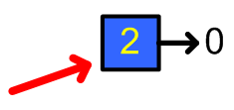
Building blocks
You have the basic building blocks to create a number of new data structures.
Based on the elements of a linked list (or extensions to this concepts).
The element (or link). An object with data and a pointer. The pointer points to another object of the same type.
A linked list is a sequence of elements (or links) connected by a pointers.

Slide 7
Building blocks
A pointer stores the head of the list.
Operations:
  Push front
  Pop front and Get front
  Push back
  Pop back and Get back
  Size to store the current length of the list

Slide 8
Observations
Linked list using pointers means that the data structures are extensible.
A stack implemented uisng an array can become full.
A stack implmented using a linekd list will not fill up (unless we run out of memory)
Useful to maintain size because this is more efficient.
Other efficiency gains are possible: see doubly-linked lists.

Slide 9
Topic 2
Stack using linked list

Slide 10
Stack
Last-In, First Out (LIFO)
A stack can be considered to be a buffer. A block of memory used to store data.
Familiar data structure.
Uses: parsing arithmetic expression, memory management (the stack on a computer), the Java virtual machine.
Implemented by using the operations:
  Push front
  Pop front and Get front

Slide 11
Topic 3
Queue

Slide 12
Queue
First-In, First Out (FIFO).
Another buffer structure.
A checkout queue at the supermarket.
Uses: packets wait in queues, single CPU processing, keyboard input, simulation (e.g. transport).
Implement using:
  Push front
  Pop back and Get back

Slide 13
Topic 4
Doubly linked list

Slide 14

Doubly linked list
An extension of the singly linked list.
Each element has two pointers not one.
The next pointer points to the next element in the list.
The prior pointer points to the previous element in the list.

Slide 15
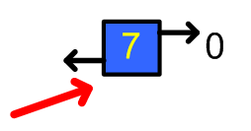
Doubly linked list
Push and pop are implemented in the same manner as a singly linked list.
But with the addition of the prior pointer.

Slide 16
Push front
The push front operation is:
  Create a new element and assign data to it.
  Set the 'prior' pointer of the element pointed to by 'head' to the new element.
  Set the 'next' pointer of the new element to point at whatever 'head' is pointing at.
  Set the 'prior' pointer of the new element to point at 0.
  Set 'head' to point at the new Element.

Slide 17
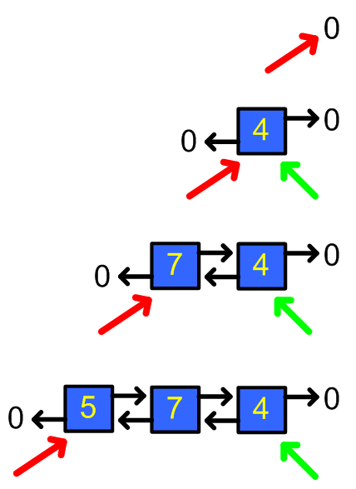
Push front

Slide 18
Push Front
void CLList::PushFront( int value )
{
CLink* tmp = new CLink( value );
if( mHead == 0 ) // first element on list
{
mTail = tmp;
}
else {
mHead->SetPrior( tmp );
}
tmp->SetNext( mHead );
tmp->SetPrior( 0 );
mLength++;
mHead = tmp;
}

Slide 19
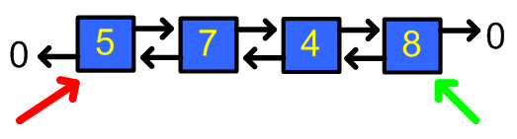
Push back
You maintain two list pointers:
  'head' points at the front of the list.
  'tail' points at the back of the list.
A push on the back of the list then becomes simple.
Do the same as push front but using the tail.

Slide 20
Push back
The push back operation is:
  Create a new element and assign data to it.
  Set the 'next' pointer of the element pointed to by 'tail' to the new element.
  Set the 'prior' pointer of the new element to point at whatever 'tail' is pointing at.
  Set the 'next' pointer of the new element to point at 0.
  Set 'tail' to point at the new Element.

Slide 21
Push Back
void CLList::PushBack( int value )
{
CLink* tmp = new CLink( value );
if( mTail == 0 ) {
mHead = tmp;
}
else {
mTail->SetNext( tmp );
}
tmp->SetPrior( mTail );
tmp->SetNext( 0 );
mLength++;
mTail = tmp;
}

Slide 22
Pop
Pop front and pop back are simple variants upon the pop operation of a singly linked list.
Need to remember to maintain the prior pointer as well as the next pointer.
Pop front uses head.
Pop back uses tail.

Slide 23
Pop Front
void CLList::PopFront( int& value )
{
CLink* tmp = mHead;
if ( mHead ) {
mHead->GetData( value );
mHead = mHead->GetNext( );
if( mHead == 0 ) {
mTail = 0;
}
else { mHead->SetPrior( 0 ); }
delete tmp;
mLength--;
}
else {cout << "ERROR: empty list" << endl;}
}

Slide 24
Pop Back
void CLList::PopBack( int& value )
{
CLink* tmp = mTail;
if ( mTail ) {
mTail->GetData( value );
mTail = mTail->GetPrior( );
if( mTail == 0 ) {
mHead = 0;
}
else { mTail->SetNext( 0 ); }
delete tmp;
}
else
{cout << "ERROR: empty list" << endl;}
}

Slide 25
Insert
Insertion into the middle of the list becomes easier since you do not have to record the previous element.
Find the location of the insertion.
  Create a new element and assign data to it.
  Set the 'next' pointer of the new element to the 'next' of the current element.
  Set the 'prior' pointer of the new element to point at the current element.

Slide 26
Remove
Removal from the middle of the list is also simplified.
Find the element.
The 'prior' pointer of the element is used to find the previous element in the chain.
The 'next' pointer of the element is used to find the next element in the chain.
The 'next' pointer of the previous element is set to point at the next element.
The 'prior' pointer of the next element is set to point at the previous element.

Slide 27
Doubly linked list
A more versatile and flexible structure than a singly linked list.
Useful if you need to insertions and removals from the middle of the list.
Useful if you need to lots of operations at the end of the list.
An example of this would be reverse display.

Slide 28
Reverse Display
void CLList::DisplayListReverse( )
{
cout << "list size is: " << GetLength( ) << endl;
CLink* search;
search = mTail;
while( search ) {
int value;
search->GetData( value );
cout << value << endl;
search = search->GetPrior( );
}
cout << endl;
}

Slide 29
Analysis of doubly linked list
Advantages over singly linked list:
  Add/remove both ends
  Faster to implement certain types of operations, e.g. pop back
  Insertion/removal in middle of list more efficient and straightforward.
Disadvantages:
  One more pointer to store, less memory efficient
  One more pointer operation for all actions, e.g. pop front operation more costly

Slide 30
Topic 5
Deque or Dequeue

Slide 31
Deque or Dequeue
Can be written either way.
A double ended queue.
Pronounced "D queue" or "deck".
Addition and removal to the front and the end of the list.
Uses: messaging systems

Slide 32
Topic 5
Trees

Slide 33
Trees
Trees are a common data structure within computing.
Possible to implement a conceptual tree using a normal list.
However, want to look at building an explicit tree structure.
Trees branch out. Different trees branch out by different amounts.
The most straightforward explanation is of a binary tree: a tree that has two branches.

Slide 34
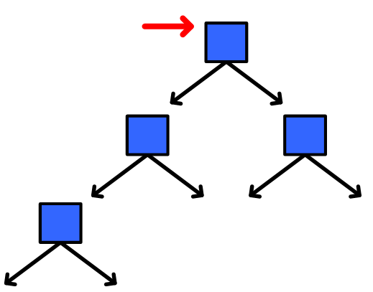
Binary Tree

Slide 35
Coding a binary tree
The elements of the tree are called nodes.
The code for a node is done in much the same way as the elements of a linked list. The node are linked together using pointers.
The number of pointers is increased.
A node on a binary tree has two pointers, each of which point at one child node. Let's call them the left pointer and the right pointer: mLeft and mRight.
It will be useful for a node to have a pointer back to its parent node: mParent.

